Slide 1


The Maharaja Sayajirao University of Baroda Faculty of Science Department of Statistics Final Year B.Sc (2024-25)
COMPARATIVE STATISTICAL ANALYSIS
OF STEM AND NON-STEM STUDENTS
Under the guidance of:
Dr. Rupal M. Shah
Ms. Shreya Mathur
A presentation by:
Puri Ankitkumar Kaushlendra
Kharva Shruti Harivadan
Acharya Matra Rajeshbhai
Jha Alokchandra Shreepati
Dheeraj Joshi

Slide 2
install.packages(“Picking_where_we_left”)
In Mid-Semester presentation, we displayed our findings based on pilot data.
Since then, we have collected 270 samples, out of which 198 are from Non-STEM students and 72 are from STEM students.
From the sample data, 49.26% are from females and 50.74% are from males.

Slide 3
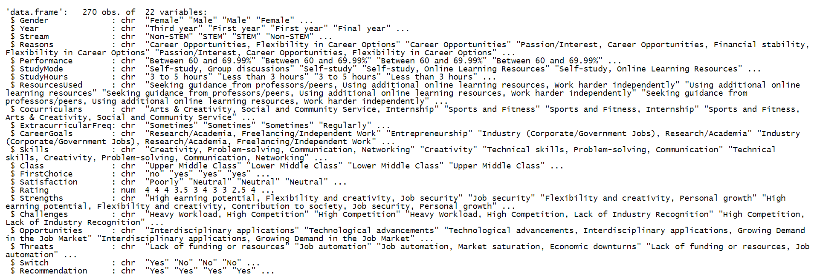
?data

Slide 4
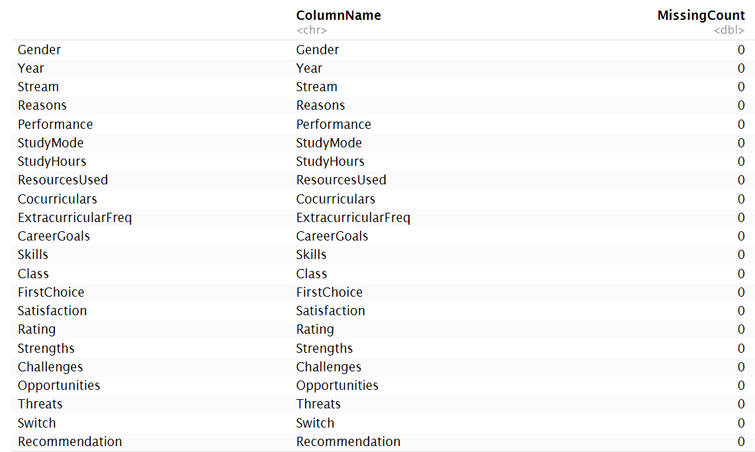
?missing.values
We find no missing observation in our data, and can safely move onto the next part.

Slide 5
# To investigate the motivating factors and reasons behind choosing STEM and Non-STEM courses
#Objective_1:

Slide 6
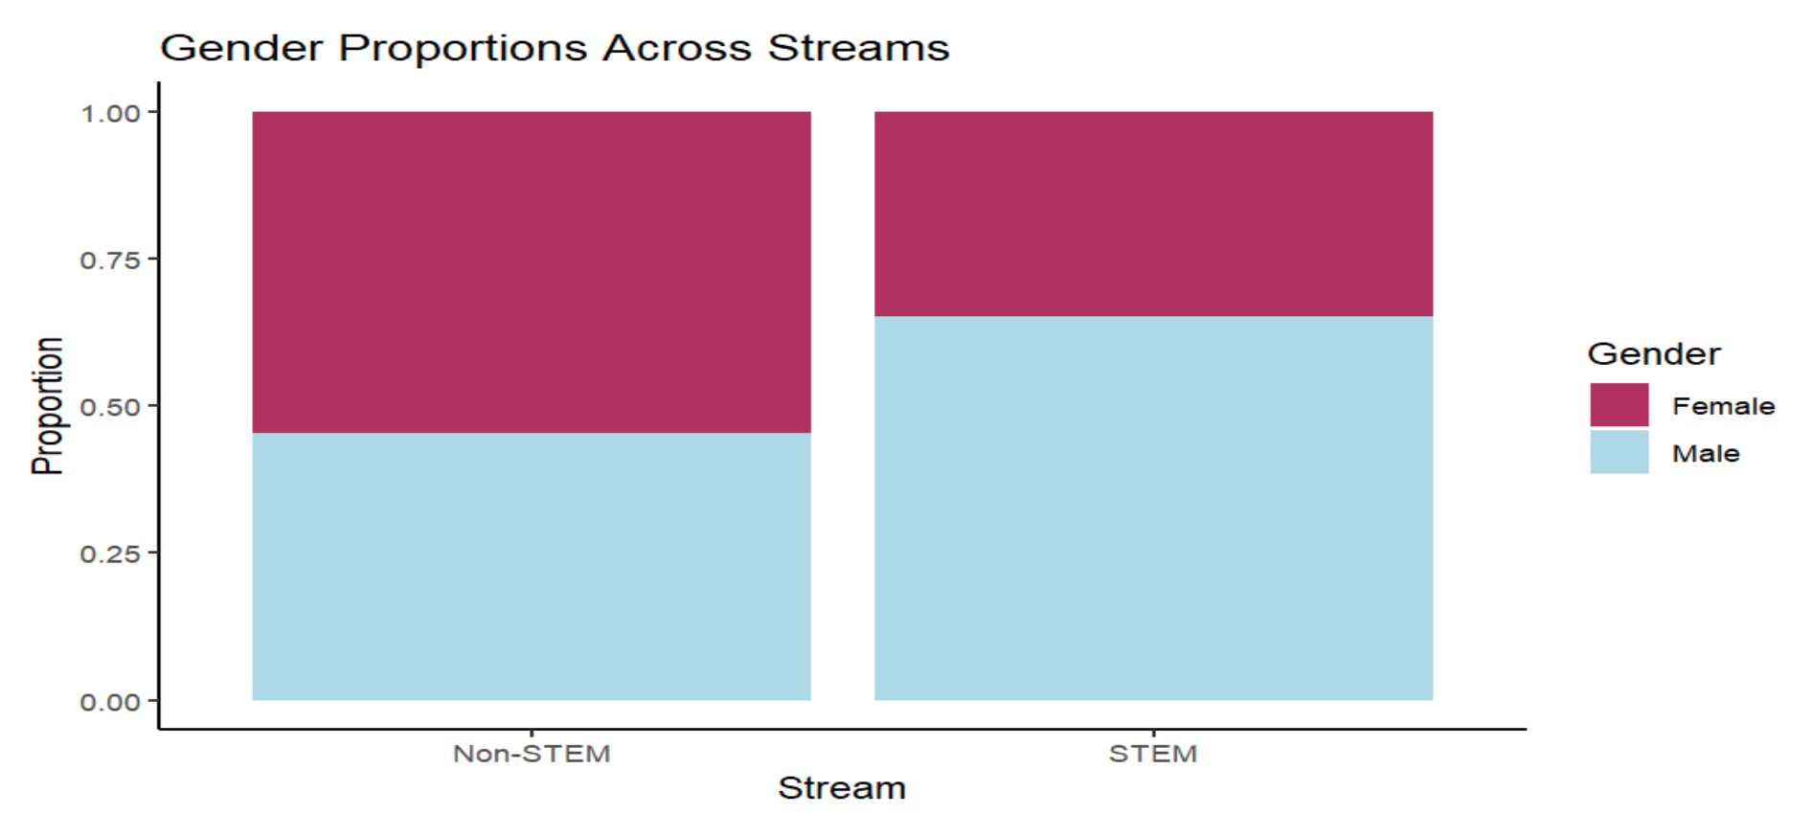
data$Stream, data$Gender
 | Stream
Gender | Non-STEM | STEM | Grand Total
Female | 108 | 25 | 133
Male | 90 | 47 | 137
Grand Total | 198 | 72 | 270
Do we have a preference of the study
fields based on gender?

Slide 7
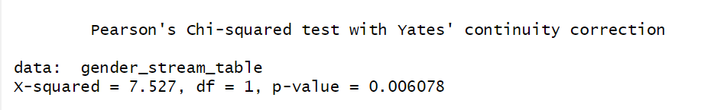
#Hypothesis:
Ho: There is no association between Gender and Stream.
H1: There is an association between Gender and Stream.
As the p-value < 0.05, we reject the null hypothesis at 5% level of significance.
Therefore, we conclude that there exists an association between Gender and Stream of students.
The study published in Global Gender Gap Report 2023, states that women make up only 29.2 per cent of all STEM (science, technology, engineering and mathematics) workers across 146 countries.

Slide 8
Standardized Pearson Residual
Expected Values
Pearson’s Residual
 | Stream
Gender | Non-STEM | STEM | Grand Total
Female | 97.53 | 35.47 | 133.00
Male | 100.47 | 36.53 | 137.00
Grand Total | 198.00 | 72.00 | 270
All residuals are between -2 and +2, so none of the individual cells stand out strongly, but they do contribute together to the overall significant Chi-square result.
Females are more likely expected to choose Non-STEM while males are more likely expected to choose STEM.
Although no individual cell exceeds ±1.96 (the usual cutoff for strong residuals at 5% level of significance), the overall pattern still supports a gender-stream association.
 | Stream
Gender | Non-STEM | STEM
Female | 1.06 | -1.76
Male | -1.04 | 1.73

Slide 9
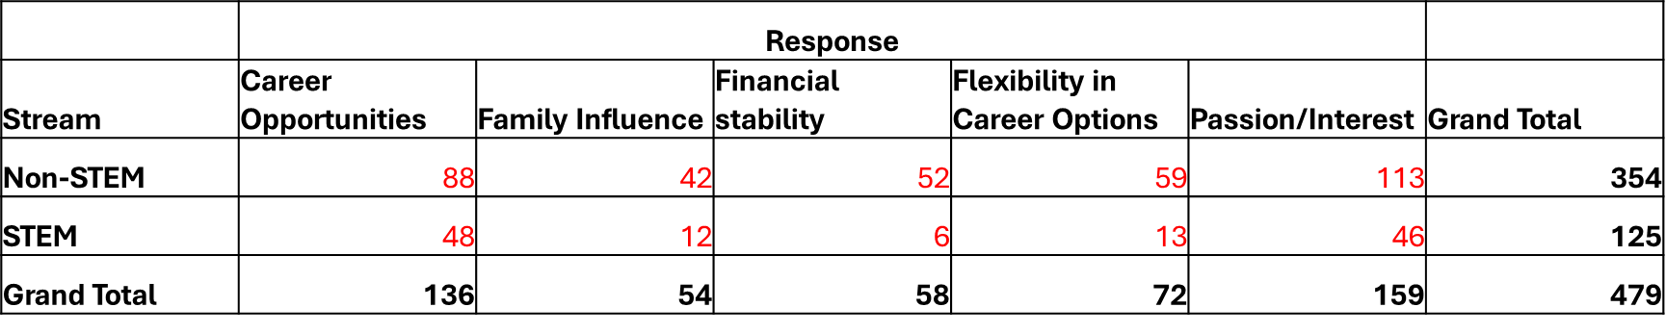
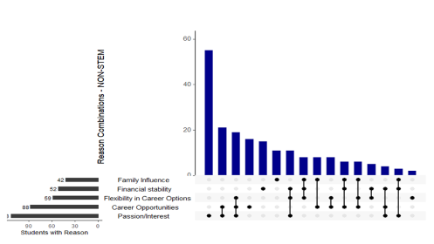
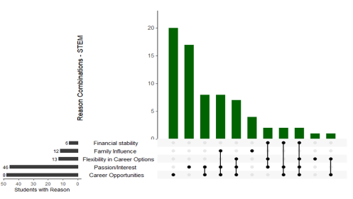
UpSet Plot
data$Stream, data$Reasons

Slide 10


Slide 11
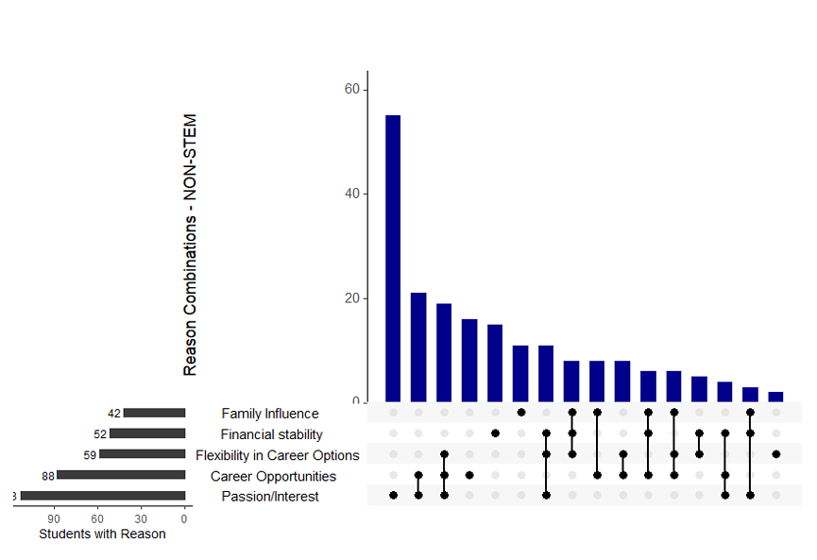

Slide 12
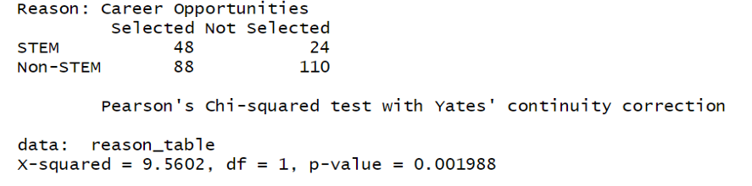
As the counts are from the multi-responses question, Chi Square Test of independence cannot be directly applied to check for association. Hence, a 2x2 contingency table is formed for each reason and subsequently, Chi Square Test is applied.
#Hypothesis:
H₀: There is no association between academic stream and reason being career opportunities.
H₁: There is an association between academic stream and reason being career opportunities.
As the p-value < 0.05, we reject the null hypothesis at 5% level of significance.
Therefore, we conclude that there exists an association between Stream and Career Opportunity being the reason of students to select a stream.
Next up, is the task to determine that which stream gives more preference to “career opportunity” as a reason to choose their field. For that purpose, one-sided proportion test is applied.

Slide 13
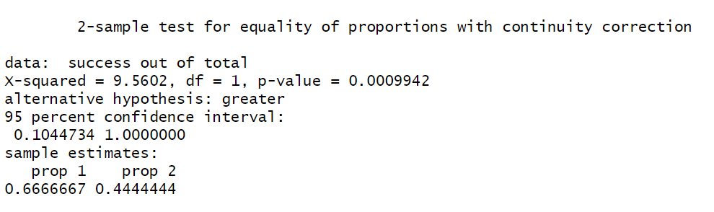
#Hypothesis:
H₀: P1 ≤ P2 (The proportion of STEM students who choose career opportunity as a primary motivation is less than or equal to the proportion of Non-STEM students.)
H₁: P1 > P2 (The proportion of STEM students who choose career opportunity as a primary motivation is greater than the proportion of Non-STEM students.)
As the p-value < 0.05, we reject the null hypothesis at 5% level of significance.
Therefore, we conclude that STEM students are more likely than Non-STEM students to cite “Career Opportunity" as a reason for their course choice.
Similarly, 2x2 contingency table is formed for each reason and following that Chi Square test is applied and proportion test is done for significant reasons.

Slide 14
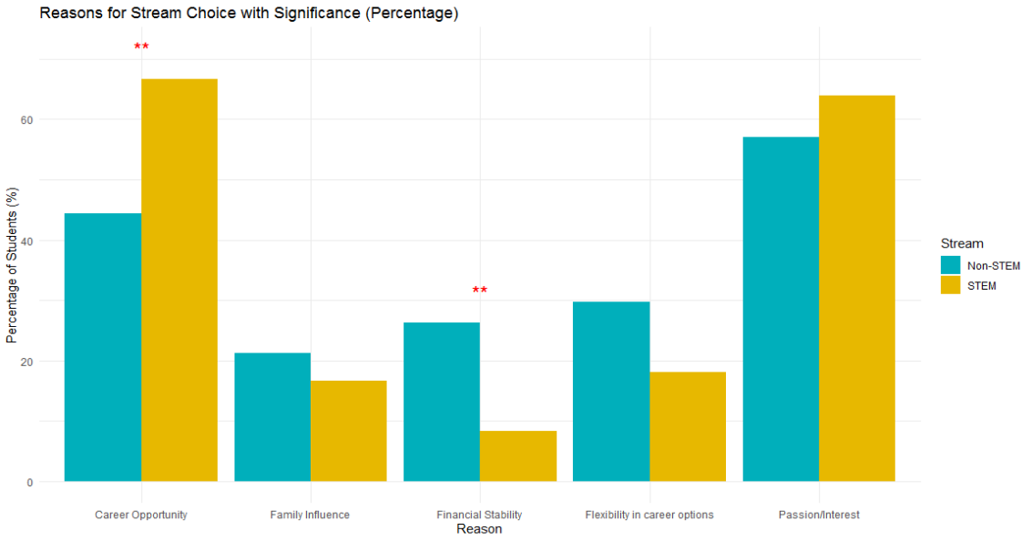
Reasons | p-value | Significance
Career Opportunities | 0.001988 | Significant
Family Influence | 0.5133 | Non-Significant
Financial Stability | 0.002659 | Significant
Flexibility in career options | 0.07608 | Non-Significant
Passion/Interest | 0.3859 | Non-Significant

Slide 15
# To compare the academic performance and study pattern of STEM and Non-STEM students
#Objective_2:

Slide 16
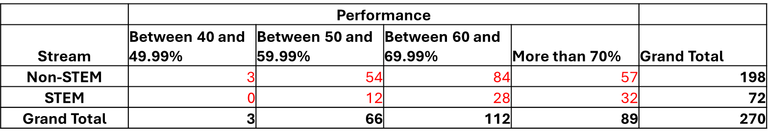
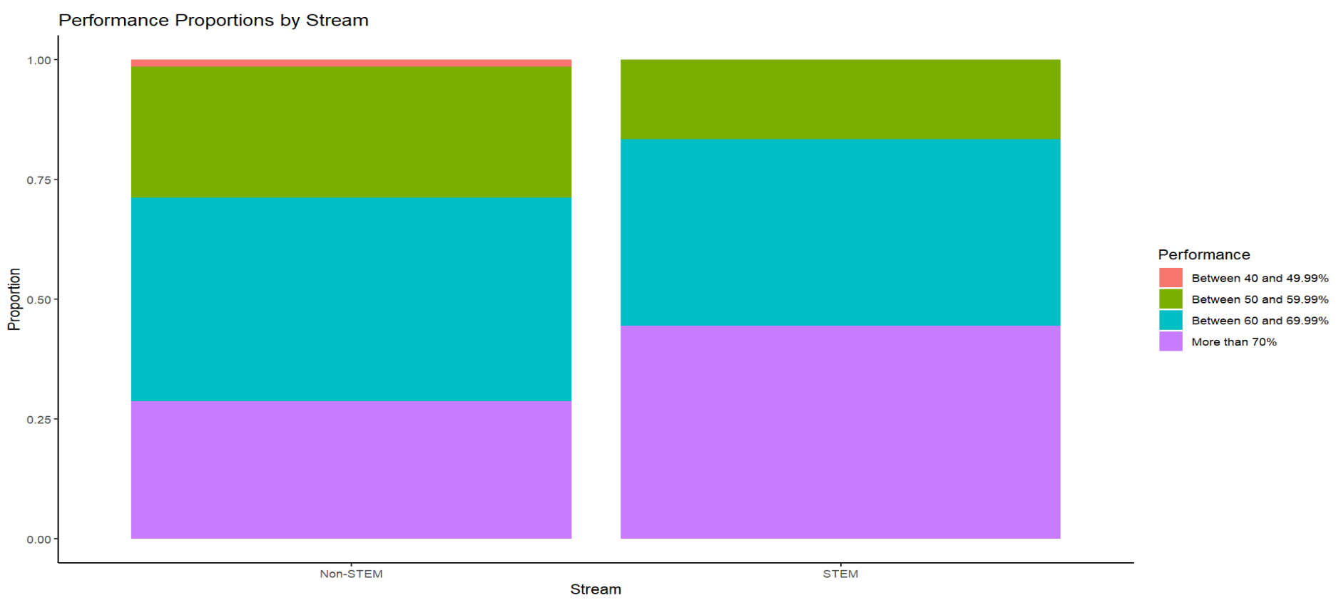
data$Stream, data$Performance

Slide 17
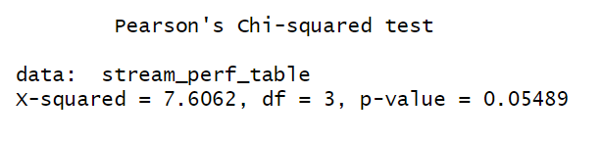

#Hypothesis:
Ho : There is no association between Stream and Performance of students.
H1: There is an association between Stream and Performance of students.
As the p-value > 0.05, we do not have enough evidence to reject the null hypothesis at 5% level of significance.
Therefore, we conclude that there exists no association between Stream and Performances of students.
The performance is not affected by the stream chosen, but can we say that there is a relationship between performance and study hours?
We move forward using Goodman Kruskal Gamma to check if there is a meaningful relationship between Performance and StudyHours per day.
The Goodman-Kruskal Gamma value of -0.019 indicates a very weak and essentially negligible negative association between Study Hours per day and Performance.
The negative sign suggests a slight tendency to perform better even with minimal but required hours of study — but the value is so close to 0 that it's likely due to random variation or noise in the data.

Slide 18
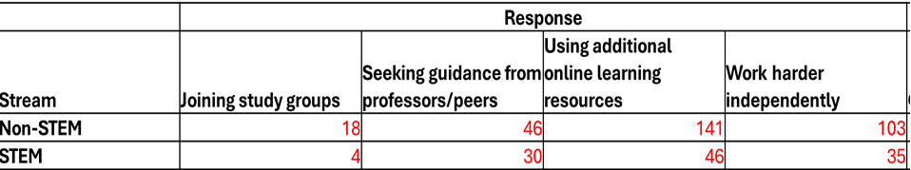
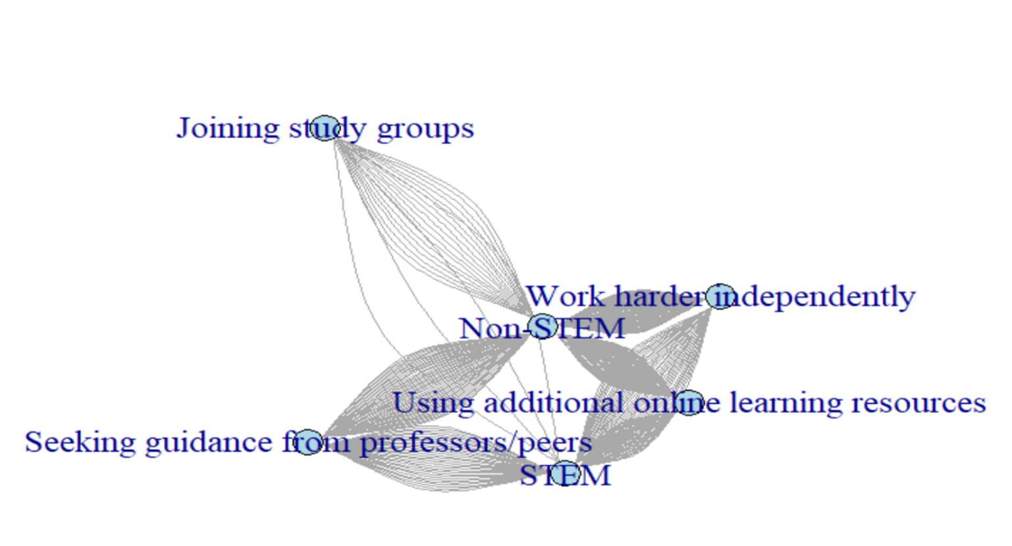
data$Stream, data$ResourcesUsed
Network graph of stream to the resources used

Slide 19




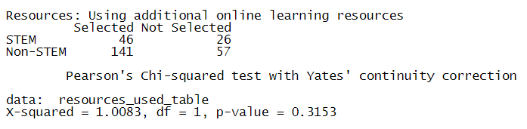
Question: Do STEM and Non-STEM students differ in the types of learning resources they use?
We presume Using additional online resources to be our variable of interest. Hence, the hypothesis is formed in the following way,
H₀: There is no association between academic stream and resources used being online resources.
H₁: There is an association between academic stream and resources used being online resources.
Resources Used | Chi-Square values | p-values | Significance
Joining study groups | 0.47266 | 0.4918 | Non-Significant
Seeking guidance from professors/peers | 7.9835 | 0.00472 | Significant
Using additional online learning resources | 1.0083 | 0.3153 | Non-Significant
Work harder independently | 0.12809 | 0.7204 | Non-Significant

Slide 20
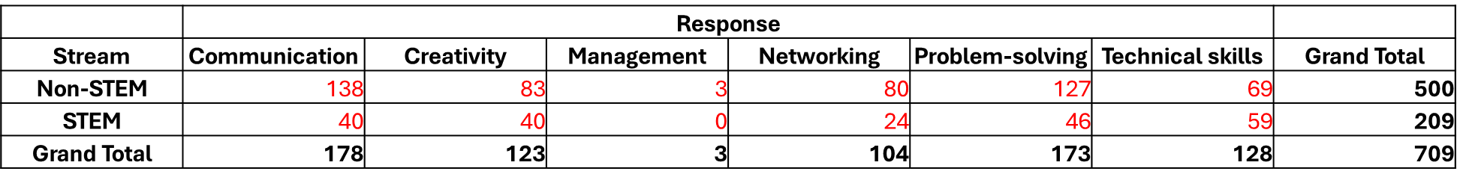
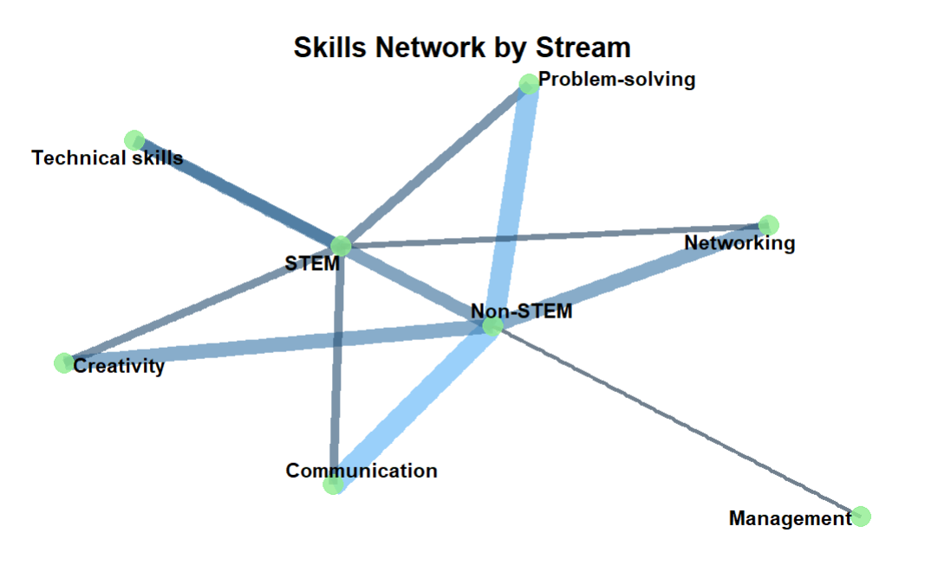
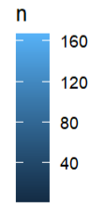
data$Stream, data$Skills
Skills Network by Stream

Slide 21
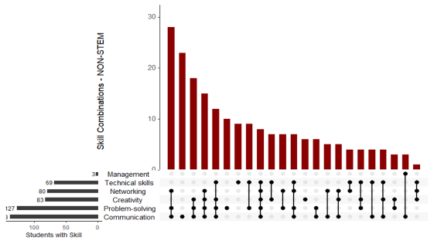
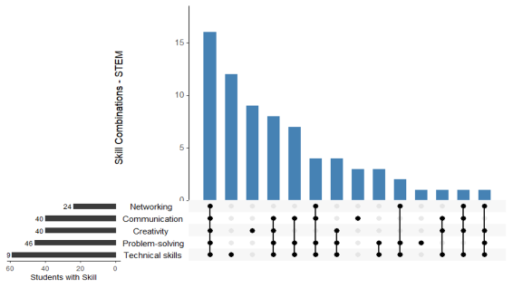
Upset Plot

Slide 22
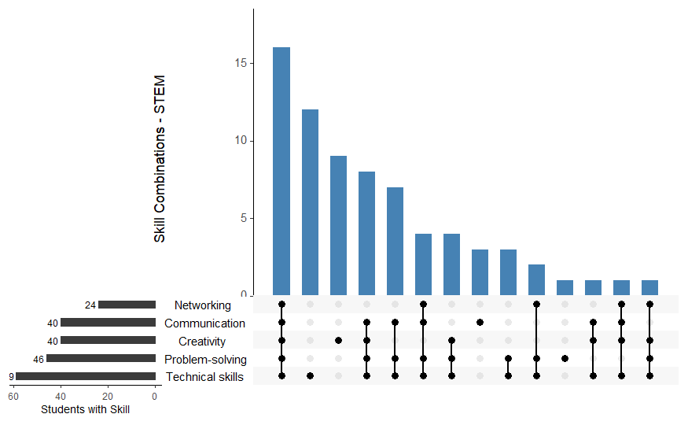

Slide 23
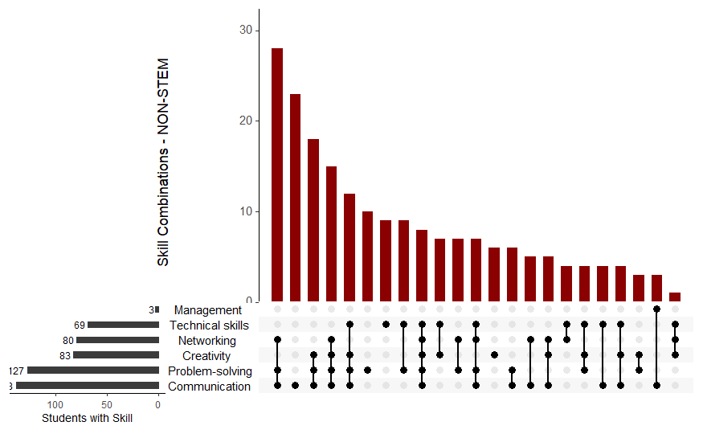

Slide 24
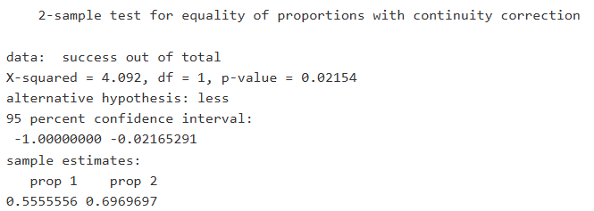
Skills | Chi-square | p-values | Significance
Communication | 4.092 | 0.04309 | Significant
Creativity | 3.4278 | 0.06411 | Non-significant
Management | 0.15513 | 0.6937 | Non-significant
Networking | 0.83609 | 0.3605 | Non-significant
Problem Solving | 1.1077e-30 | 1 | Non-significant
Technical Skills | 45.101 | 1.871e-11 | Significant
As communication shows a significant value for difference in proportion, we conduct a test presuming that students in Non-STEM fields require more communication skill comparatively.
H₀: P1 ≥ P2(The proportion of STEM students require Communication skill is greater than or equal to the proportion of Non-STEM students.)
H₁: P1 < P2 (The proportion of STEM students require Communication skill is less than the proportion of Non-STEM students.)
Here, p-value < 0.05, hence we reject null hypothesis at 5% level of significance.
Therefore, we conclude that Non-STEM student have more requirement of communication skill than STEM student.

Slide 25
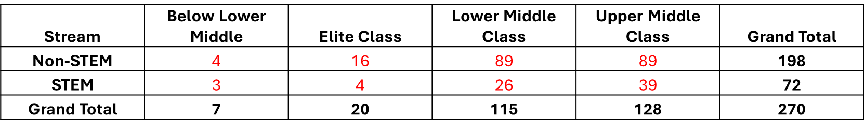
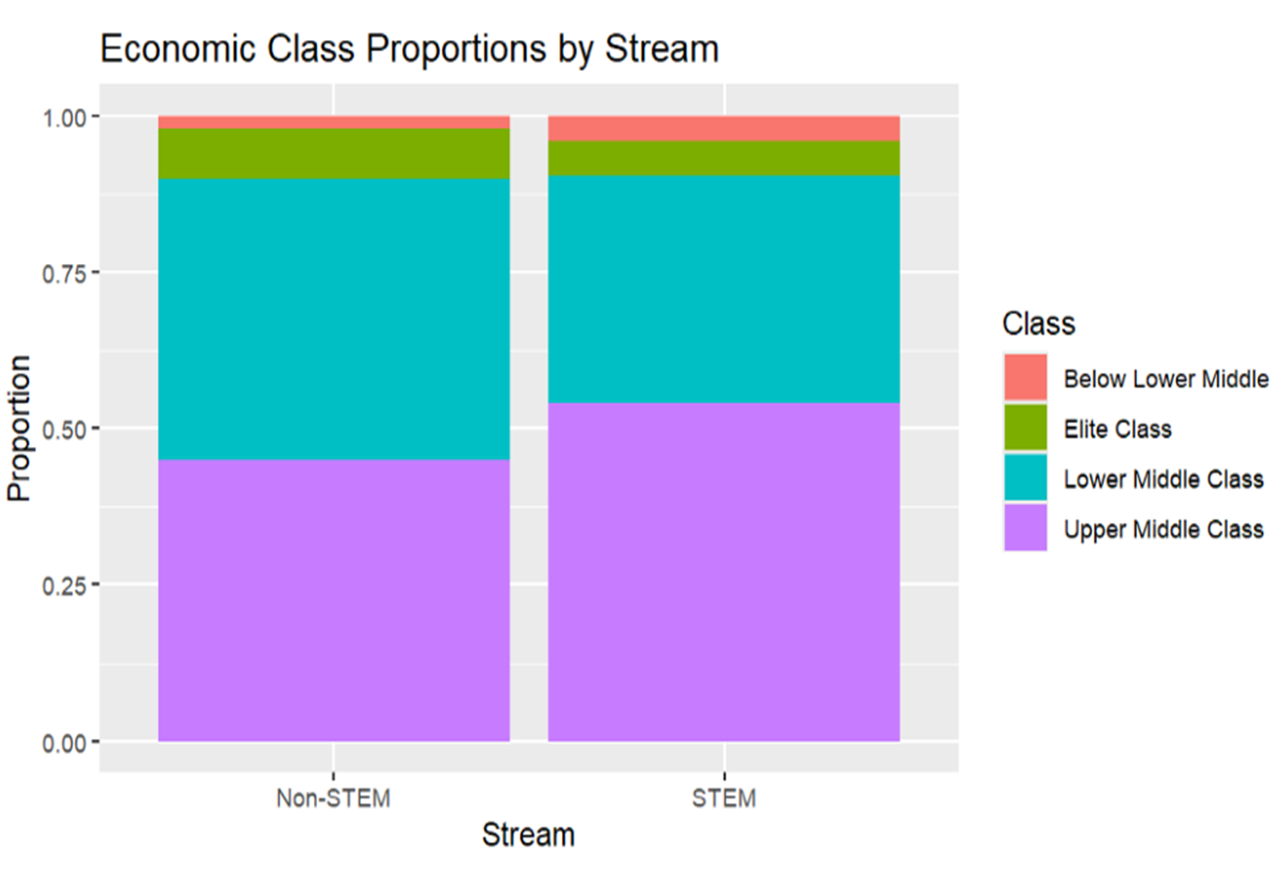
data$Stream, data$EconomicClass
Do we observe significant difference in students choosing STEM or Non-STEM fields by their economic status?

Slide 26

#Hypotheses:
H₀: There is no association between Stream and Economic class.
H₁: There is an association between Stream and Economic class.
Here, p-value > 0.05, therefore we do not have enough evidence to reject the null hypothesis at 5% level of significance.
Economic status of a student is not a measure that significantly determines choice of field.
According to Family Socioeconomic Status and Choice of STEM Major in College, students from low socio-economic background have a lower representation in STEM, but the same is not reflected in our sample.

Slide 27
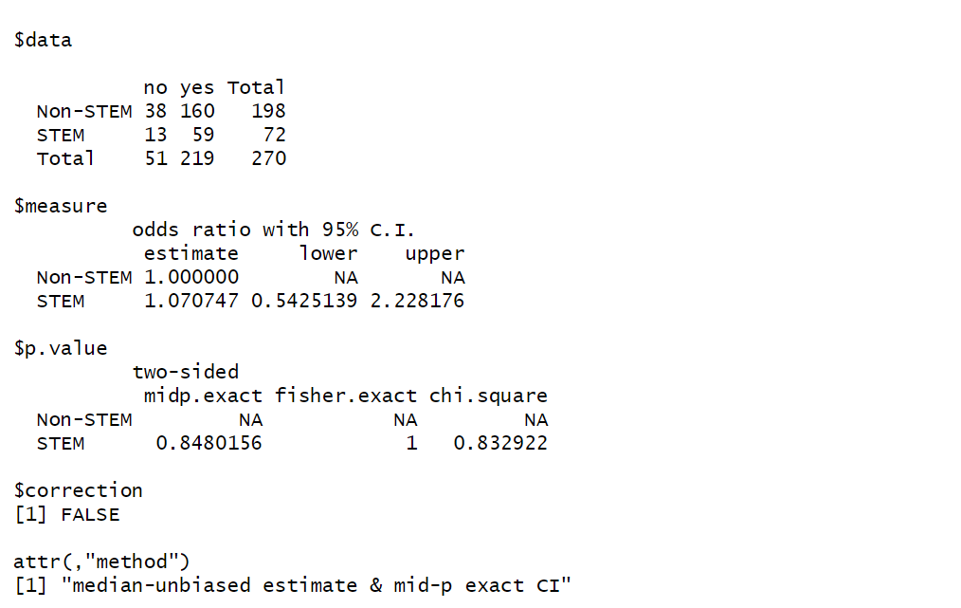
data$Stream, data$FirstChoice
Here, we aim to study that is there any evidence to conclude that students of any specific stream are studying the field as their first choice.
All p-values are much higher than 0.05, so no statistically significant association between stream (STEM vs Non-STEM) and response to FirstChoice.
Odds ratio (OR) for STEM = 1.071
This means students in STEM are 7.1% more likely to say “Yes” to FirstChoice compared to Non-STEM students.
But here's the catch, the 95% Confidence Interval is from 0.543 to 2.228. Since 1 falls within the CI, the result is not statistically significant.

Slide 28
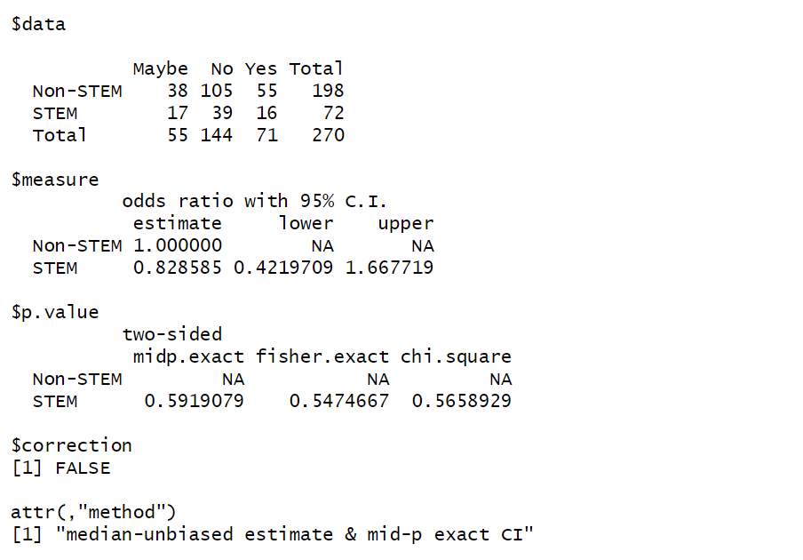
But is there any association between Stream and Switching?
Odds ratio (OR) for STEM = 0.8285
This means students in STEM are 17.18% less likely to switch their field of study compared to Non-STEM students.
But the 95% Confidence Interval is from 0.421 to 1.667. Since 1 falls within the CI, the result is not statistically significant.
Although the odds ratio suggests STEM students are slightly less likely to switch than Non-STEM students, this difference is not statistically significant (p > 0.5). So, we can’t confidently say there’s a real difference between stream and switching.

Slide 29
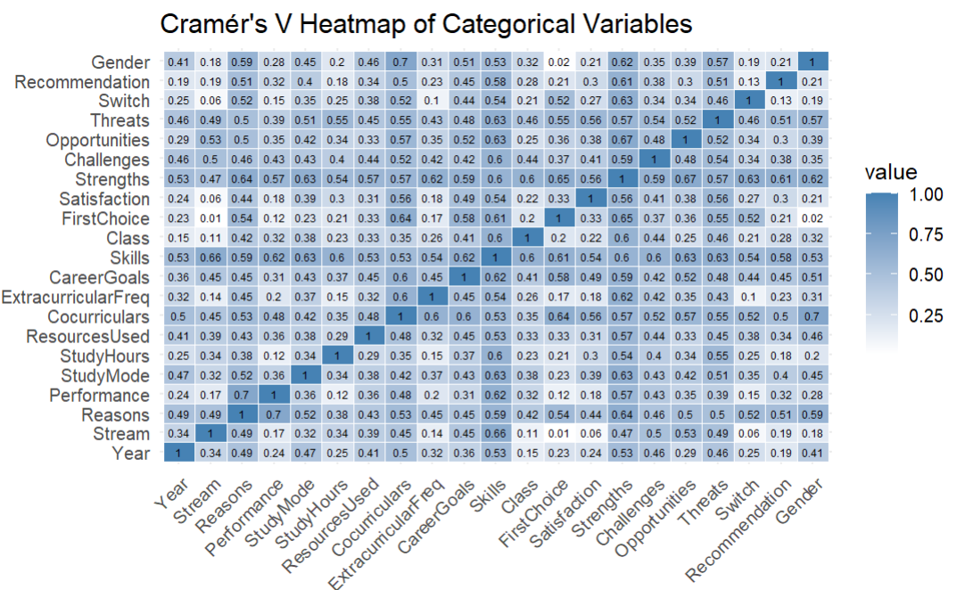
?associations
We now aim to find the association between all the variables present in the data. The tool we use for this purpose is Cramer’s V.

Slide 30
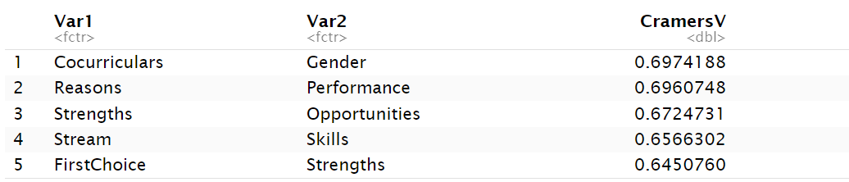
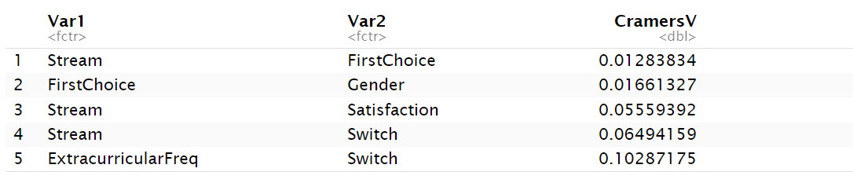
Top 5 associations
High association between Co-curriculars and Gender may suggest that Males and Females do have a preference for co-curricular activities.
Bottom 5 associations
But wait, there is low association between Stream and FirstChoice? Does this mean that most of students are not studying according to their first choice?

Slide 31
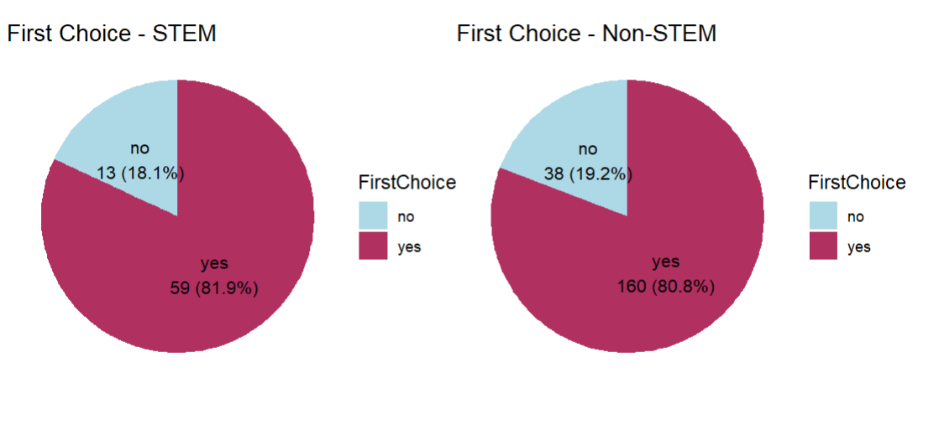
We observe from the pie graph that the proportion of students studying STEM or Non-STEM as their first choice is nearly the same. This explains the low value of association between the variables.

Slide 32
#Objective_3:
# To perform SWOT analysis for STEM and Non-STEM fields

Slide 33
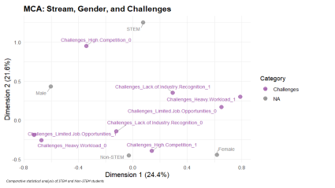
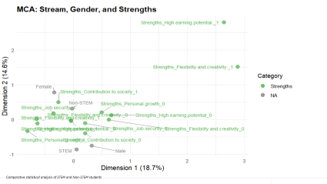
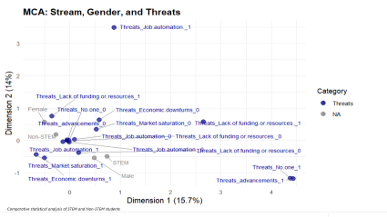
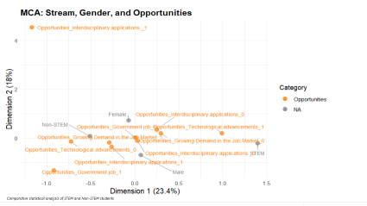
SWOT Analysis by MCA Plot

Slide 34
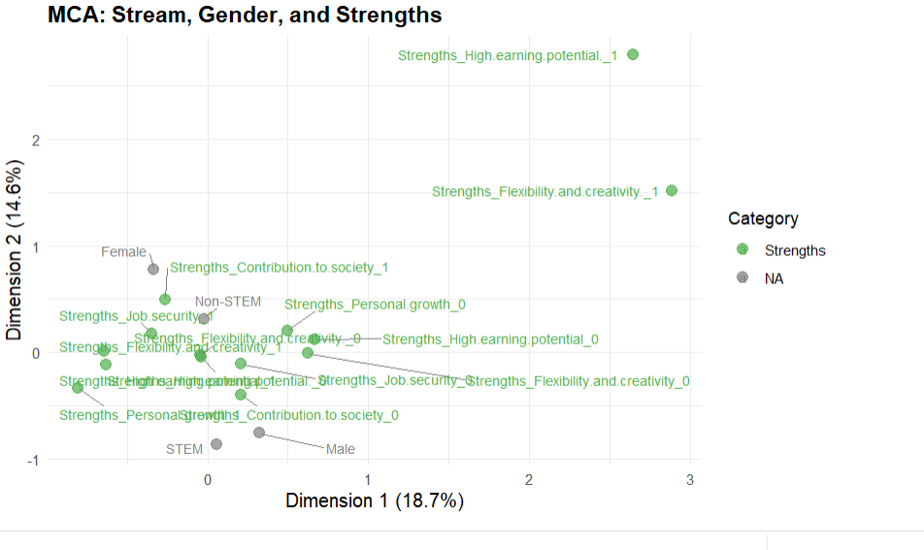

Slide 35
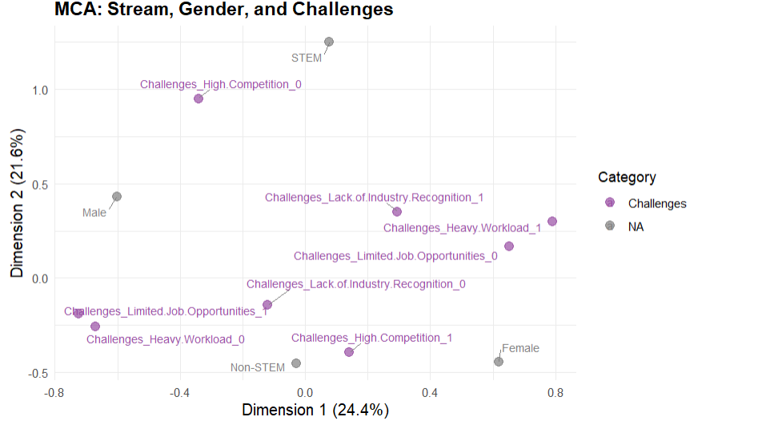

Slide 36
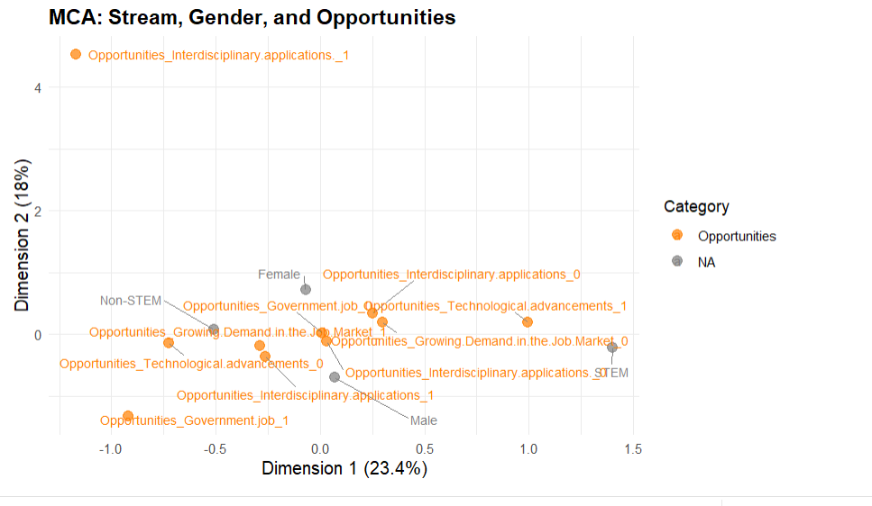

Slide 37
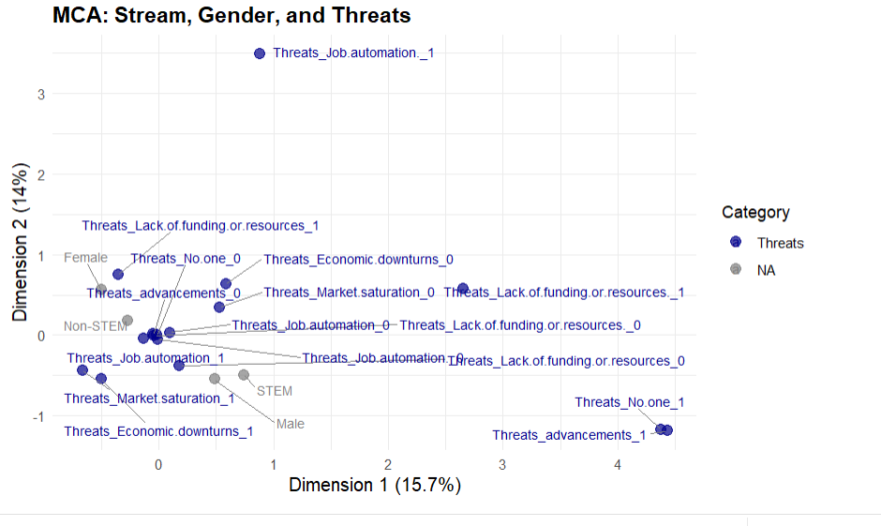

Slide 38

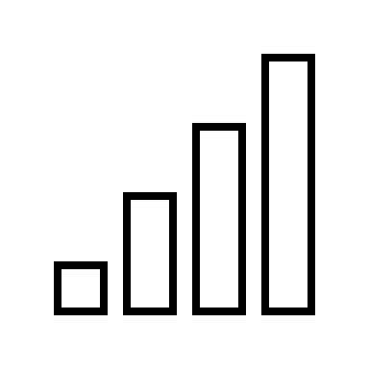







summarize(key_findings)
GENDER & STREAM
MOTIVATION DIFFER
PERFORMANCE
STUDY HOURS & PERFORMANCE
RESOURCES USED
Significant association found. Female more likely to choose Non-STEM while Male more likely to go for STEM
STEM: Driven by passion/ interest(intrinsic)
Non-STEM: Influenced by external factors like career prospects
No significant difference between STEM and Non-STEM performances
Similar patterns across both streams, no stream exclusive usage
No meaningful correlation found.
CO-CURRICULARS
CAREER GOALS
SKILLS VALUED
FIRST CHOICE AND SWITCHING
ECONOMIC BACKGROUND
STEM: Sports & Fitness
Non-STEM: Arts, Creativity and Social Service
STEM leans toward research
Non-STEM prefers Industry and Entrepreneurship
Significant association found. Female more likely to choose Non-STEM while Male more likely to go for STEM
No significant difference.
No significant stream- based relation found with economic background

